Slide 1


Twitter Sentimental Analysis
Guided By:
Dr.Arvind Jagtap
Project By:
Sudip Konde
Tanmay Khedekar
Yash Tagunde
Prem Urkude

Slide 2
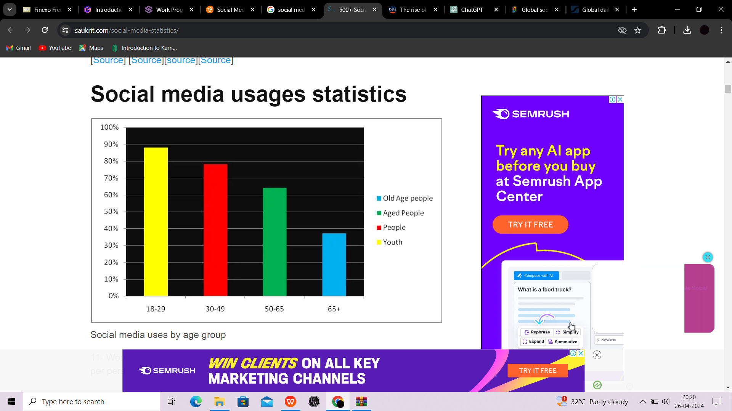

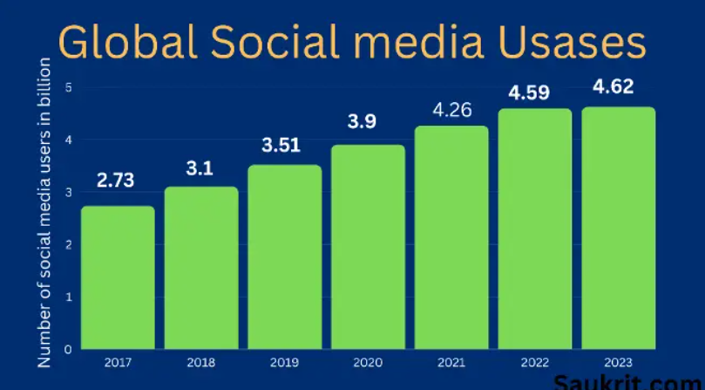
HOW THE SOCIAL MEDIA USE INCREASING

Slide 3
TABLE OF CONTENTS
1
INTRODUCTION
2
OBJECTIVE
3
LITERATURE SURVEY
4
BLOCK DIAGRAM
5
TOOLS AND LANGUAGE
6
FUTURE WORK
7
REFERENCES
8
CONCLUSION

Slide 4

Introduction
Twitter, with its vast user base and real-time nature, has become a treasure trove of opinions, emotions, and trends. In today's digital age, understanding the sentiment expressed on Twitter is invaluable for various purposes, from gauging public opinion on political issues to assessing customer satisfaction for brands.
The Twitter Sentiment Analysis project aims to leverage advanced natural language processing (NLP) and machine learning (ML) techniques to analyze the sentiment embedded within tweets. By classifying tweets into categories such as positive, negative, or neutral sentiments, this project seeks to provide valuable insights into the collective mood of Twitter users.
In this project, we will explore various NLP and ML algorithms, preprocess text data, extract relevant features, and train models to classify tweet sentiments. By employing state-of-the-art techniques and methodologies, we aspire to build a reliable tool that contributes to a deeper understanding of the sentiments expressed on Twitter.

Slide 5
Objective
OUR AIM
THE GOAL
To develop a functional classifier capable of accurately and automatically classifying the sentiment of tweets.
This involves the use of natural language processing (NLP) and machine learning (ML) models to determine whether a tweet expresses negative, positive, or neutral emotions within its text
Additionally, the project aims to build a model capable of detecting sentiment in tweets, enabling the application of this model to analyze and interpret sentiments expressed on the Twitter platform
The goal of the project is to develop a functional classifier capable of accurately analyzing and categorizing the sentiment expressed in tweets
To extend the project and use it for all Social meia platform

Slide 6
Literature Survey
Sr.No | Literature Title | Author | Findings
01 | "Sentiment Analysis of Twitter Data: A Survey of Techniques" | by AI Baqapuri | This survey explores sentiment analysis techniques specifically tailored for Twitter data, addressing the challenge of analyzing sentiments within the context of tweets
02 | "Sentiment Analysis of Twitter Data" | by Y Wang | This research paper provides a comprehensive review of sentiment analysis techniques applied to Twitter data, emphasizing the use of computational methods to process subjective information in tweets
03 | "Twitter sentiment analysis" | by ResearchGate | This paper reports on the design of a sentiment analysis system, focusing on extracting sentiment from a vast amount of tweets using prototyping methodologies
04 | "Twitter Sentiment Analysis using Python | Introduction & ..." | by Analytics Vidhya | This resource provides insights into various techniques used for analyzing sentiments in tweets using Python, offering practical guidance for building sentiment analysis models

Slide 7
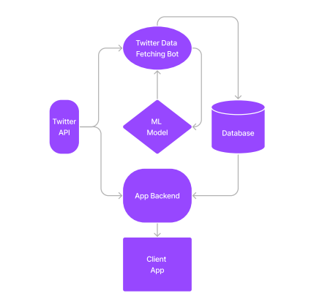
Block Diagram

Slide 8
Tools AND Language
Python Programming Language: Python is widely used for its simplicity, extensive libraries for data manipulation, and machine learning capabilities, making it suitable for sentiment analysis .
CSS and JavaScript: Used For the Frontend
NLP Libraries: Utilize Natural Language Processing (NLP) libraries such as NLTK (Natural Language Toolkit) or spaCy for text preprocessing, tokenization, and feature extraction.
Machine Learning Frameworks: Incorporate machine learning frameworks like Scikit-learn or TensorFlow for building and training sentiment analysis models [4].
Twitter API: Access Twitter data through the Twitter API to collect tweets relevant to the analysis. Libraries like Tweepy facilitate interaction with the Twitter API.
TextBlob or VADER: Employ sentiment analysis libraries like TextBlob or VADER for sentiment polarity classification of tweets [5].
Development Environment: Set up an integrated development environment (IDE) like Jupyter Notebook or PyCharm for efficient coding and experimentation.

Slide 9
Future Work 🚀
Enhanced Model: Explore advanced NLP techniques, such as deep learning models like LSTM or Transformer, to improve sentiment classification accuracy.
Multi-language Support: Extend the analysis to multiple languages by incorporating multilingual sentiment analysis techniques
Real-time Analysis: Develop mechanisms for continuous data ingestion and real-time sentiment analysis to provide up-to-date insights.
Domain-specific Analysis: Customize the sentiment analysis model for specific domains or industries, such as finance, politics, or customer service.
Social Impact: Investigate the application of sentiment analysis in understanding public opinion trends, crisis management, or brand reputation monitoring.
Interactive Visualization: Create interactive dashboards or visualizations to allow users to explore sentiment analysis results dynamically.

Slide 10
References
"Sentiment Analysis of Twitter Data: A Survey of Techniques" - A research paper by V. Kharde (2016) providing an overview of sentiment analysis techniques applied to Twitter data
"Sentiment Analysis of Twitter Data" - Research exploring recent developments and algorithms in sentiment analysis on Twitter, authored by multiple contributors (2022)
"Twitter Sentiment Analysis Using Python | Introduction & ..." - A technical documentation article on Analytics Vidhya explaining techniques for building Twitter sentiment analysis models using Python (2021)
"Sentiment analysis using Twitter data: a comparative ..." - A research paper by Y. Qi (2023) examining sentiments in tweets through lexicon and machine learning methods
"Twitter sentiment analysis" - A paper detailing the design and development of sentiment analysis on Twitter data, utilizing prototyping methods, authored by unspecified authors (2016)
"Sentiment Analysis of Twitter Data" - A research paper by Y. Wang (2022) reviewing various sentiment analysis techniques applied to Twitter data

Slide 11
Conclusion
The conclusion for a Twitter sentiment analysis project typically summarizes the findings and implications of the study:
Identification of Sentiments: The project successfully classified tweets into positive, negative, or neutral sentiments, revealing the overall sentiment distribution within the dataset
Applicability of NLP: Natural Language Processing (NLP) techniques proved effective in processing and analyzing large volumes of Twitter data, showcasing the potential of NLP in sentiment analysis tasks
Insights into Public Opinion: By analyzing sentiments expressed on Twitter, valuable insights into public opinion on various topics or events were obtained, which can be leveraged for decision-making and trend analysis
Future Directions: The project suggests avenues for future research, such as exploring more sophisticated machine learning algorithms or incorporating contextual information for sentiment analysis improvement .
In conclusion, Twitter sentiment analysis offers valuable insights into public sentiment, enabling organizations to better understand and respond to trends and opinions in real-time.

Slide 12
THANK YOU

